Slide 1
UKRAINE SIG 101

Slide 2
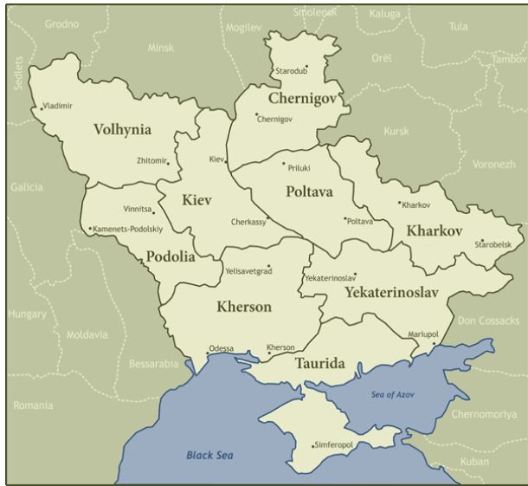
Ukraine
Map
1910
ext here

Slide 3
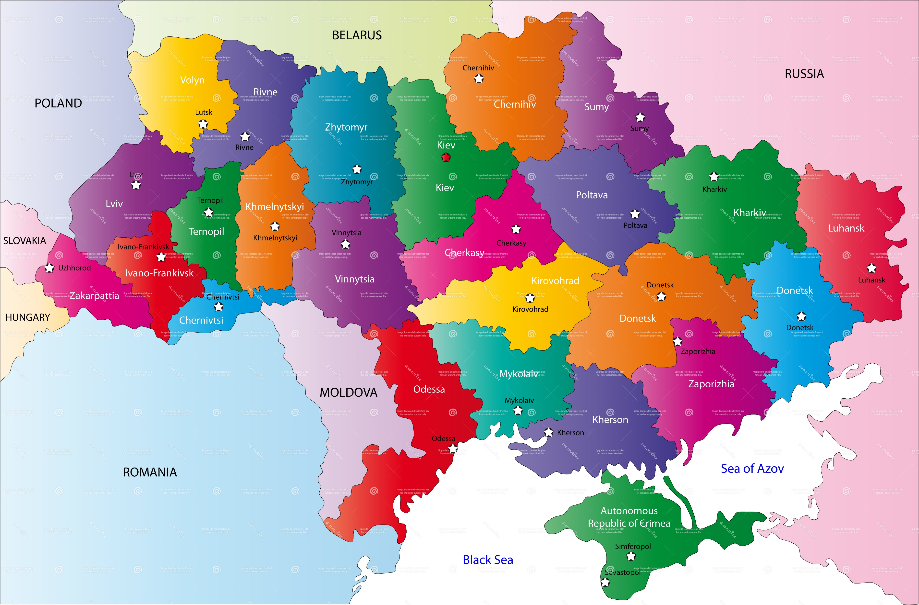

Slide 4
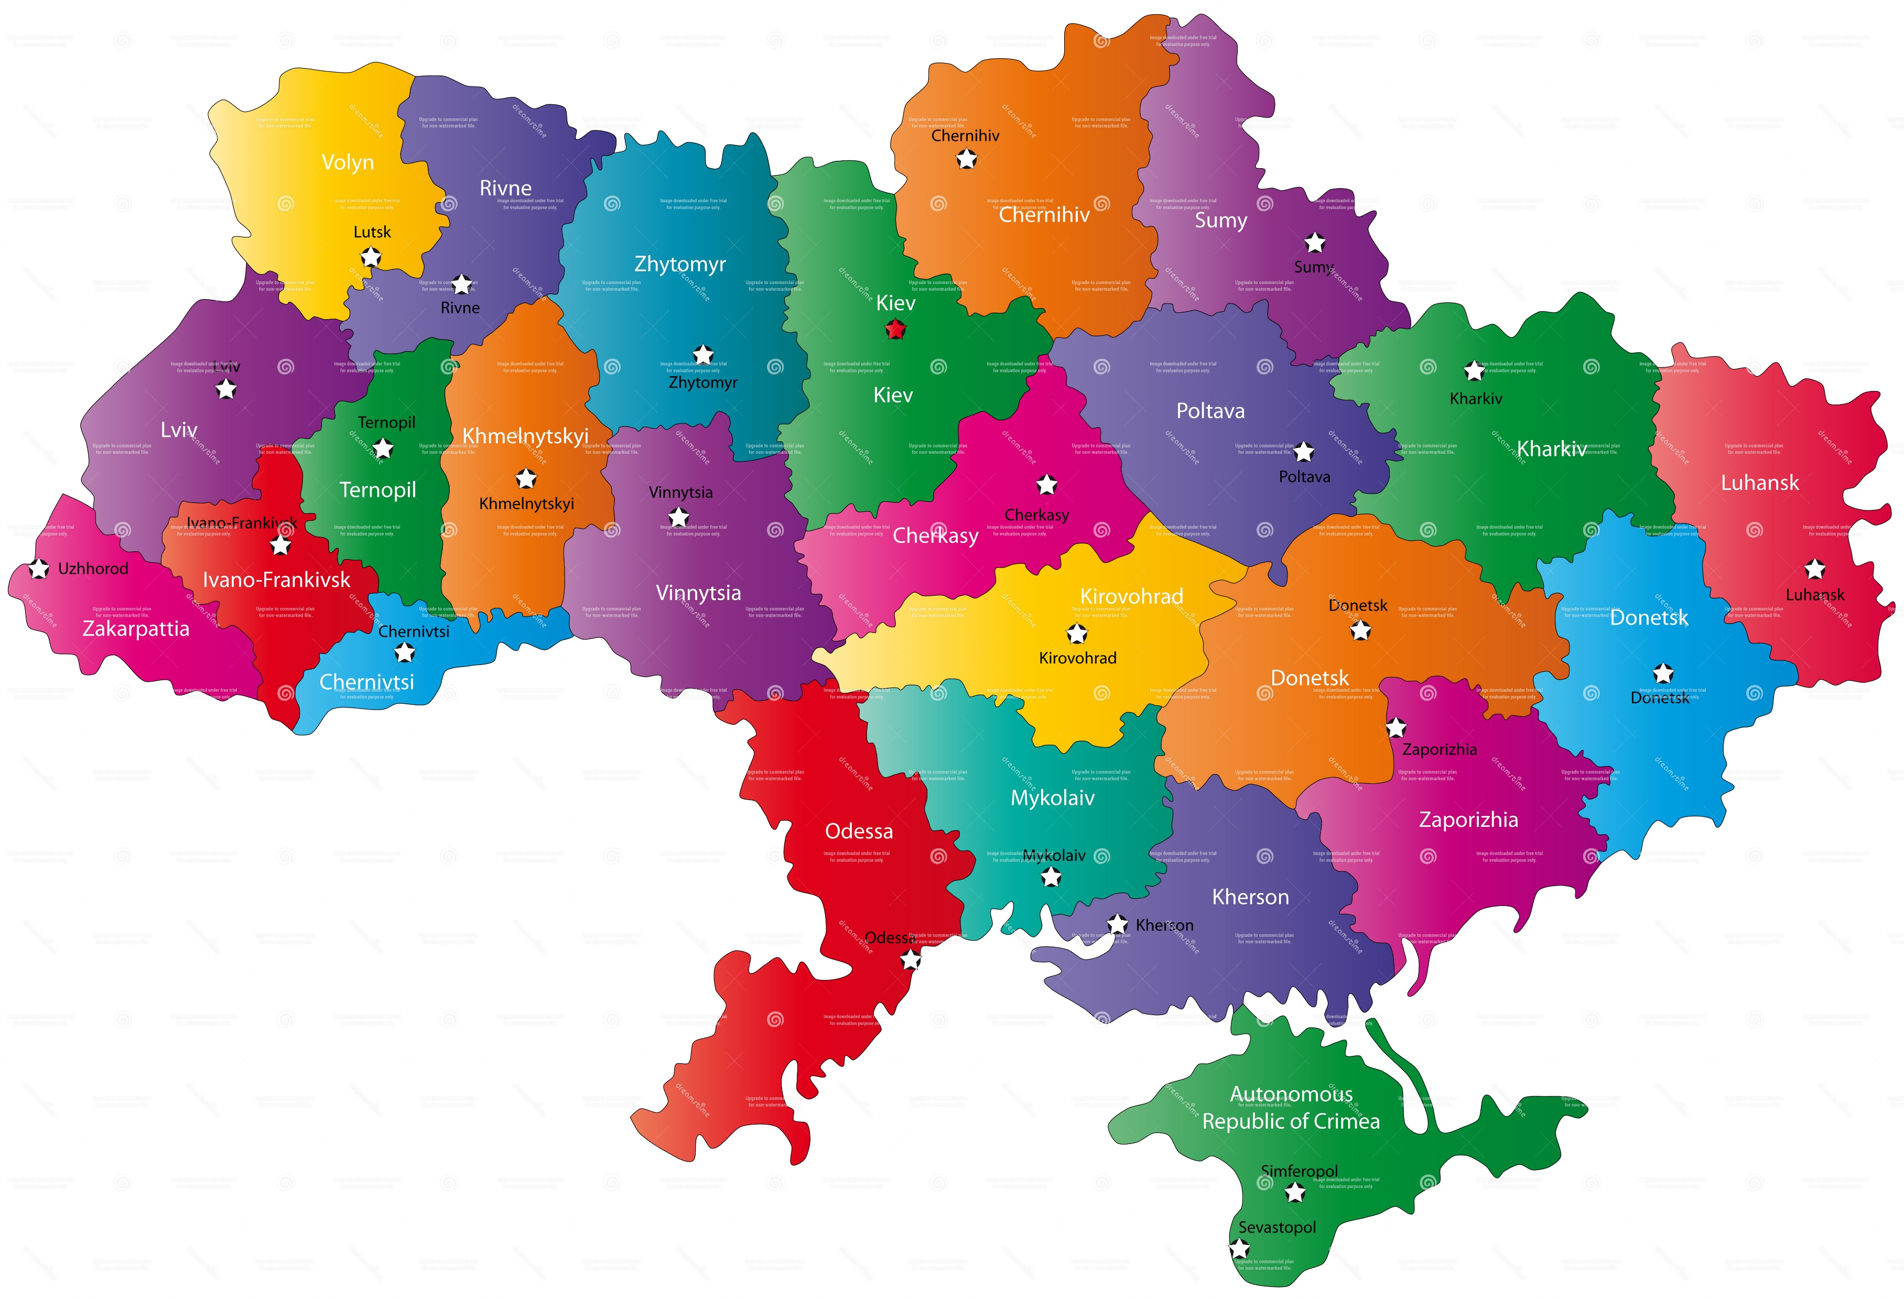

Slide 5
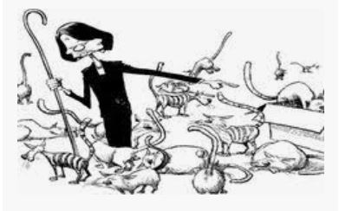

Slide 6
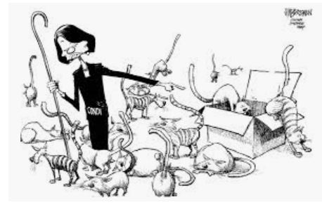

Slide 7
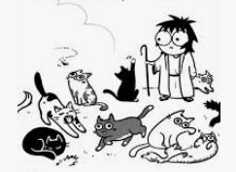

Slide 8
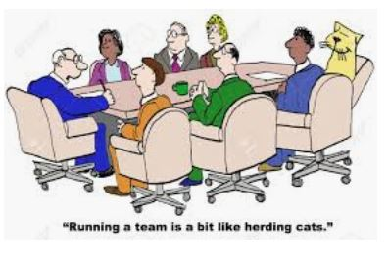

Slide 10
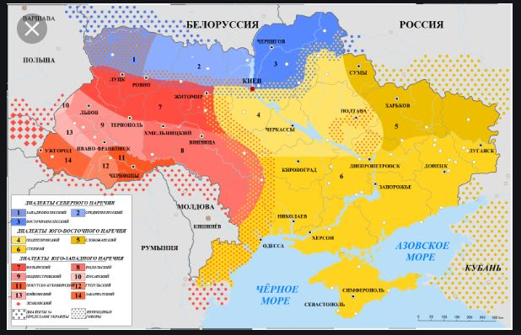

Slide 11
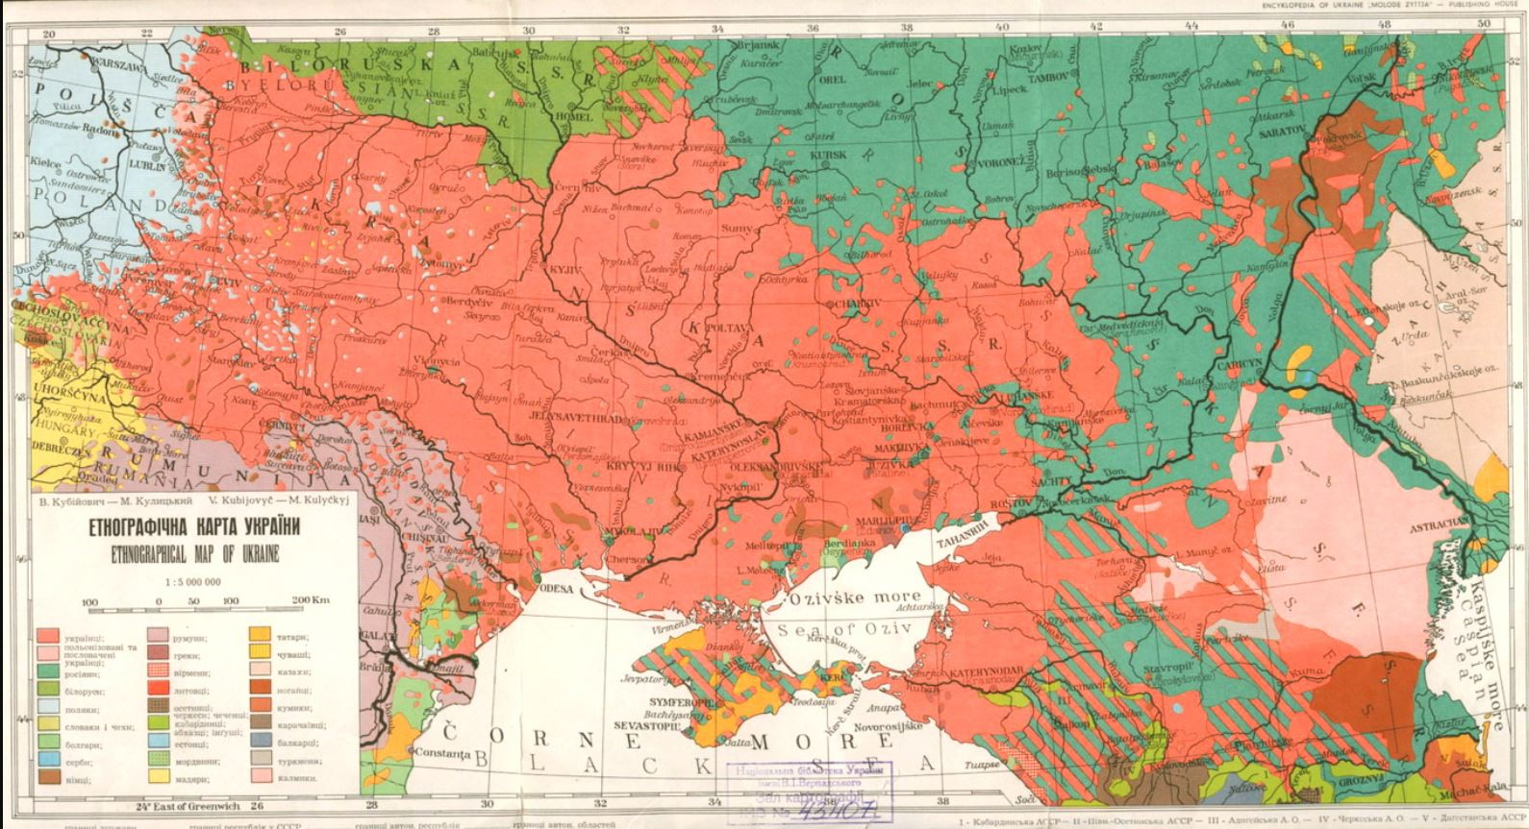

Slide 12
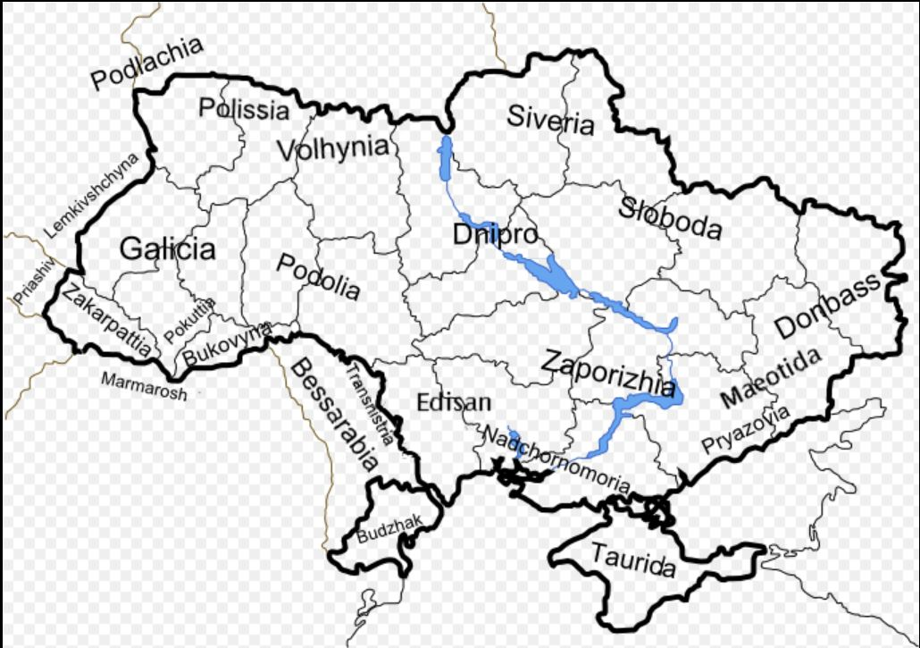

Slide 13
What Does the Ukraine SIG Do ?
Provides a platform for those with ancestors from Ukraine to find sources for research
Fosters research for towns in Ukraine through a network of town leaders
Locates and acquires records and documents related to Jewish genealogical research

Slide 14
Assists by locating and referring translators
Along with JewishGen, provides information on various aspects of research

